Slide 1

Retail Business Data Analysis and Recommendation
Prativa Bikash Khatua

Slide 2
BUSINESS CONTEXT
To provide data-driven insights and strategies to the client, a well - known retail chain in India, in order to improve CRM, marketing, campaigns, and sales performance through the utilization of historical point-of-sales data.
Understanding Customer Behavior
Product and Category Analysis
Enhancing Store and Channel Effectiveness
Sales Trend and Forecasting
Improving Customer Satisfaction
Key Business Insights and Recommendations

Slide 3
Problem statements
Identify sales metrics – TOTAL REVENUE/NUMBER OF ORDERS/VAERAGE ORDER VALUE/PROFIT/WEEKLY/DAILY/MONTHLY TRENDS
Understanding preference of the customer – TOP SELLING PRODUCTS PER CATEGORY/TIME/PRICE/REPEAT PURCHASES/RATING
Understanding store performance – Compare/sales/revenue/stores/location/avg sales per store
Understanding category and product performance – revenue contribution per product category/profit making category
Identify the risk factor ln sales – Continue decrease in revenue based on store/region/district

Slide 4
Over-View of Tables
Table name | No. of columns | No. of rows | Granularity | Primary key | Foreign key | Parameters/details
Customer | 4 | 99,441 | Customer level data | Customer id | NA | Customer-id, city, State and Gender.
 |  |  |  |  |  | Data given for total 99,441 unique customers
Stores info | 4 | 535 | Store level data | Store id | NA | Store-id, seller city, seller State and Region
 |  |  |  |  |  | Data given for 534 unique stores across 4 region and 19 States/UTs
Products info | 9 | 32,951 | Product level data | Product id | NA | Product-id, category, product name length and description length, product photos quantity, product dimensions and weight
 |  |  |  |  |  | Data given for 32,951 unique products over 13 categories while category of some product-id is not given

Slide 5
Over-View of Tables
Table name | No. of columns | No. of rows | Granularity | Primary key | Foreign key | Parameters/details
Orders | 11 | 1,12,650 | Order level data | NA | Customer-ID | Customer-id, order-id, product-id, channel, store-id, bill date time stamp, quantity, unit cost, MRP, discount and total amount
 |  |  |  |  | Product-ID Store-ID | Data given for 98,666 unique orders for all 32,951 products across 37 stores from 7 States
Order payment | 3 | 1,03,886 | Order level data | NA | NA | Order-id, payment type and payment value
 |  |  |  |  |  | Data has been given for 99,440 unique order regarding their payment details
Order review ratings | 2 | 1,00,000 | Order level data | Order ID | NA | Order-id, customer satisfaction score
 |  |  |  |  |  | Data has been given for 99,441 unique order id including all 98,666 order id given in order table

Slide 6
Over-View of Tables
Order table
Customer Table
OrdersPayment Table
THEIR RELATIONS
StoresInfo Table
OrderReview Table
ProductsInfo Table

Slide 7

Relationships
As order table is a fact table and is connected with dimension table by means of a shared key
Customer Table – 1/2/many relationship/Order Table
Order Table – 1/2/1 relationship/Customer Table
ProductsInfo Table - 1/2/many relationship/Order Table
Stores Info Table - 1/2/many relationship/Order Table
OrderPayments Table - many/2/many relationship/Order Table
OrderReview Table - 1/2/1 relationship/Order Table

Slide 8
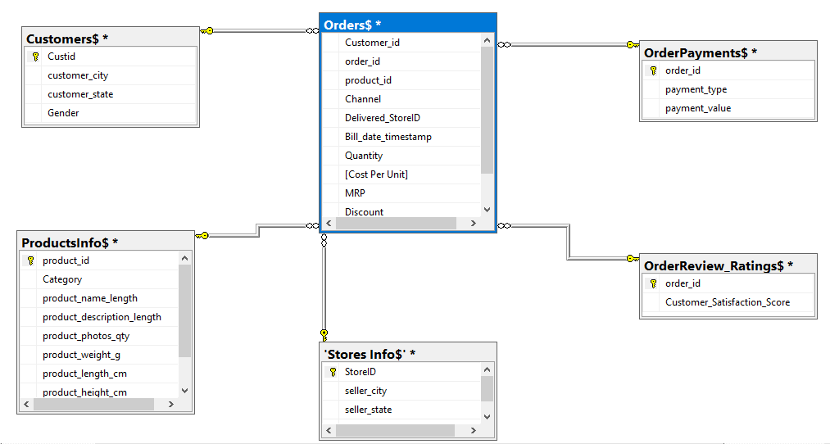
ER Diagram
Primary Key
Primary Key
Primary Key
Primary Key
Primary Key

Slide 9
Exploratory Data Analysis
Customer_360 - Customer information , 96811 records
_Order360_ - Information about Order , 98078 records
_store360_ - Information about stores , 37 records

Slide 10
High Level Metrix
Customer Level Information
Order Level Information
Total Customers : 98,311
Total Customer City : 4,109
Average Profit per Customer : 23.83
Average Discount per Customer : 4.98
Average Sales per Customer : 160.50
Average number of category per Customer : 1.04
Average number of Days b/w two Transactions : 5
Total Orders : 98.0k
Total Quantity : 1,11,897
Total Channels : 3
Total Payment method : 4
Average Discount per Order : 5.01
Average Order Value : 135.27
Average profit per order 17.09
Day having maximum no of order Wednesday
Channel preferred by maximum order : Instore

Slide 11
High Level Metrix
PRODUCT LEVEL
SALES LEVEL INFORMATION
Total Category : 14
Total Product : 32,887
total revenue 15.45 M
total cost 13.26721491 M
total discount 0.491799 M
discount percentage 3.18
avg discount per order 5.01
avg bill value 157.29
avg sales per customer 159.6
avg profit per customer 22.23
avg no of items per order 1.11
one time buyer percentage 97.66%
avg rating per store 4.06
highest profitmaking store ST103
STORE LEVEL
Total Stores : 37
Total Region : 4
Total Seller City : 37
Total State : 7

Slide 12

EXPLOROTARY DATA - ANALYSIS

Slide 13
Region Wise
Exploratory Data Analysis
Store Wise Data Analysis
Recommendation – here we can identify the top most profit making region based on that we can advertise/publish offers/give discounts/cross selling

Slide 14
Exploratory Data Analysis
Store Wise Data Analysis
Here we can target south customer according to their spending habit by giving offers/discounts

Slide 15
Exploratory Data Analysis
Store Wise Data Analysis

Slide 16
Exploratory Data Analysis
Store Wise Data Analysis
Recommendation
we can understand customer preferences and trigger their expenses by offering sales, advertisements, and special offers
Cross-Selling – we can target customers for cross-selling by offering them discounts, credit/debit card discounts, and special promotions
Also we can use combo offer/buy one get one offer strategy.

Slide 17
Exploratory Data Analysis
Customer Wise Data Analysis

Slide 18
Exploratory Data Analysis
Customer Wise Data Analysis
Out of all customer there are 59.75 % people who don’t wish to buy discounted product rest 40.26 wish to buy
Note. Those calculation based on assuming 0/- profit standard

Slide 19
Exploratory Data Analysis
Store Wise Data Analysis

Slide 20
Exploratory Data Analysis
Store Wise Data Analysis
Here we can identify the customer percentage and their preferable payment type
As max cust prefers instore purchase by visiting the store then we can advertise accordingly like cross selling, buy one get one, discounts/limited offer

Slide 21
Exploratory Data Analysis
Store Wise Data Analysis
Top 10 stores with highest rating
We can see top 10 category with highest rating
Here we can identify the product trend in top ranking stores and can utilise that also

Slide 22
Exploratory Data Analysis
Both are important for business to generate more sales in profit making category we have to provide some offers/discounts/sales/quick delivery and in business running category we can give them combo offers/quick delivery/discounts and loyalty rewards to make them more loyal

Slide 23
Exploratory Data Analysis
Top 10 worst revenue generating stores in terms of sales
Here we can find what things matter for business price/time/demand based on that we can advertise
Like for price we can give discounts for time we can give quick delivery for demand we can add demanded product with less demanded product

Slide 24
Exploratory Data Analysis
Top 10 most expensive product
Top 10 most expensive product belonging category

Slide 25
Exploratory Data Analysis
Top 10 Cross selling products
Baby
Construction_Tools
Furniture
Luggage_Accessories
Baby
Furniture
Home_Appliances
Furniture
Construction_Tools
Baby
Construction_Tools
Baby
Luggage_Accessories
Furniture
Furniture
Baby
Furniture
Home_Appliances
Home_Appliances
Home_Appliances

Slide 26
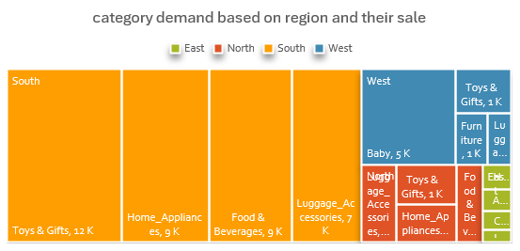
Exploratory Data Analysis
As there is a growth in a particular category in a particular region so there can be chances of high mortality rate in that region.
So to increase more sales in our business we can add more variety and we can give more offers/discount and also we can do cross selling to increase revenue and also we can give extra combo offers to our loyal customers.

Slide 27
Exploratory Data Analysis

Slide 28
Exploratory Data Analysis
Recommendation- based on rating we can track our sales and demand based on that we can target customers after observing their needs by providing discounts/offers/combo sales offer
Based on this we can provide discounts/offers/sales like one day offer in top revenue generating category and also in top business running category by balancing each category

Slide 29
Exploratory Data Analysis
Recommendation- we can give discounts and offers in weekday transaction area to increase performance by offering discounts/quick delivery/

Slide 30
Top 5 revenue generating category
Exploratory Data Analysis
Top selling category across all stores
As per the Data we can see toy and gift are generating revenue but profit making category is home appliance so we have to create a connection between those category to increase more profit.

Slide 31
Exploratory Data Analysis
Store Wise Data Analysis
As we can see maximum customer prefer credit card purchase in this case we can provide maximum reward giving strategy or cash back offers and also as they are using credit card in instore purchase then we can do cross selling here

Slide 32
Exploratory Data Analysis
Order Wise Data Analysis
Recommendation – Maximize the product/category from where the demand is coming by advertisement/discount/cross selling/ buy two get 50% off and also use the same method in bottom revenue generating stores.

Slide 33
Exploratory Data Analysis
Customer Wise Data Analysis
Recommendation – As the Maximum order is purchased through store then to increase sells we can give various offers/discount/quick service/cross selling buy two get one by observing the locality.
As we can see channel online is making less revenue as comparison to instore and phone delivery so here we have to give offers/discounts/rewards/quick delivery to enhance its performance.

Slide 34
Exploratory Data Analysis
Customer Wise Data Analysis

Slide 35
Customer Satisfaction
Observations :
Pet Shop and Food & Beverages have the highest ratings.
Furniture have the lowest ratings.
By store, ST138 has the highest rating.
By state, West Bengal has the highest rating.
By seller city, Ponnur has the highest rating.
By month, August has the highest rating.
By category, Pet Shop contributes the highest rating.
Recommendation :
Highlight customer reviews and ratings to build trust and encourage purchases.
Investigate the reasons for low ratings in these categories, such as product quality, pricing, or delivery issues.
Analyze the factors contributing to high ratings in August, such as product mix, promotions, or customer service
quality, and replicate these strategies in other months.
Develop strategies to elevate other underperforming categories, ensuring consistent customer experience across all offerings.

Slide 37
Exploratory Data Analysis

Slide 38
Exploratory Data Analysis
It shows top 5 category that trend based on product date
By which we can identify why particularly on that day there is a increase in sales for any festival or for any occasion on that basis we can give advertisements and offers(combo/buy one get one) and discounts

Slide 39
Exploratory Data Analysis
Here we can identify why the product ordered maximum times like(price/offer/discount/delivery time)based on that we can target customers.

Slide 40
Exploratory Data Analysis
There are 37 stores but st103 store performing best
Recommendation -by analysing their sale trend we can identify y the sale is going up is that for location or for time or for price or discount

Slide 41
MoM Growth Analysis
Exploratory Data Analysis
From 2021 to 2023, sales kept growing strongly, with big peaks in November and December 2022. In 2023 also, sales were stable and good. But in September 2023, there was a sudden big drop — only 92 orders — which is not normal. This needs to be checked properly to find the reason. To continue the growth, we should focus more on high-sales months, fix the September issue, and plan better sales strategies for the second half of the year.

Slide 42
Understanding the YoY growth
Exploratory Data Analysis
As we can see minimal 2020(0) revenue growth in the base year as there is no prior year to compare.
These 2021(99.1),2022(99.19) two years show nearly 100% year-over-year revenue growth
There is a sharp drop in revenue in 2023(20.54)
Recommendation - We can improve by identifying y and it is all related to 2021 and 2022 sales

Slide 43
Recommendation on customer behaviour
Exploratory Data Analysis
Analyse customer behaviour to understand what customer is preferring and what is their need and in which time they are preferring to buy and maximum on which day.
Based on this we can perform advertisements/ also can offer some offers.
Also we can track who prefers discount and how much of them hurry for purchase without seeking discount.

Slide 44
Recommendation on Product Behavior
Exploratory Data Analysis
we can identify which product in famous or in demand based on that we can perform some cross selling advertisements
and we have to identify profit making product based on that sales we can add combo sales advertisement with sales demanded product
we can identify state/location/region where the demand is more according to that we can diversify also

Slide 45
Recommendation on Store behaviour
Exploratory Data Analysis
AS we have 37 stores based on that we can identify which store is generating more sales and which store is generating more profit based on that we can cross sell product by advertisements/discount offers/weekend sales/buy 2 get 1
And also some stores are generating less revenue so 1st identify what is the reason behind in sell is it for price/location/time of delivery
Then perform advertisements according to that

Slide 46
Sells Recommendation
Overall if we are combining all customer/ product/store then it all matters on customer need/interest/ego, so we can full fill that need by identifying his preference based on time.
As there are 3 type of payment method but max customer prefer instore purchase so here we can advertise more, provide them more offers like family pack/combo discounts and we can add cross selling also
For online payment buyer may be upi/debit/credit we can advertise them by providing more discounts if purchasing two and we can help them by decreasing the sell time also.

Slide 47
Exploratory Data Analysis

Slide 48
RFM segmentation
Exploratory Data Analysis
We segmented customers into (Premium, Gold, Silver, Standard) using RFM analysis based on their last purchase date, number of purchases, and expenses
It shows, Frequency, and Monetary value, then assigns them a segment total spending. Based on that we can target customers by observing their activity and spending habit through offers/discounts.

Slide 49
Exploratory Data Analysis
The revenue segmentation shows that a majority of customers fall into the low revenue segment, while a small fraction contribute as very high revenue customers. Here low count customer with high revenue making maximum revenue than high count customer.
So, we have to focus on loyalty programs the maximum revenue making customers by offering promotion/offers/discounts.
By cross selling strategy we can help to increase sells of medium revenue generating segment.

Slide 50

Thank You

Slide 51
Recommendation
Product Level - Buy 2 from Category A, Get 1 from Category B at 50% off/Cross selling/Sells/Offers/Product in One Click
Payment Level - Discount/Reward/Coupons/Cash back
Customer Level – Gifts like free Parking/Premium Service/Customer of the week by revenue/
Store Level - Reward to revenue making customer/Store Discount/Store Voucher like 10% discount upto 1 year in 199/

Slide 52
customer id and their maximum time preference of category
top 10 customer id and their used category
here we can identify are they loyal or one time buyer according to that we can trigger them based on discount/offer/delivery time/price/advertisements

